Slide 1
SARS-CoV-2 Nucleotide Database
Alexa Anderson
BIOI4870

Slide 2
Goal and Objective
The goal of this database was to create a small-scale COVID-19 genomic database that can be queried by accession number, lineage, or source country in order to return relevant sequences for research.

Slide 3

Background
SARS-CoV-2 is a virus the public is very familiar with
Its study is still relevant even as the pandemic lessens in the public’s mind
COVID-19 has multiple variants and frequently mutates
a database to house representative sequences of each with corresponding data can make keeping track and comparing variants easier

Slide 4
Data Collected
Source | Data Type | Quantity
NCBI Virus | Metadata CSV and genomes in fasta format | 198 Samples
EMBL-EBI COVID-19 Data Portal | Metadata CSV and genomes in fasta format | 52 Samples
GISAID Reference Sequence | Genome in fasta format, metadata collected manually | 1 Sample
Total |  | 251 Samples

Slide 5
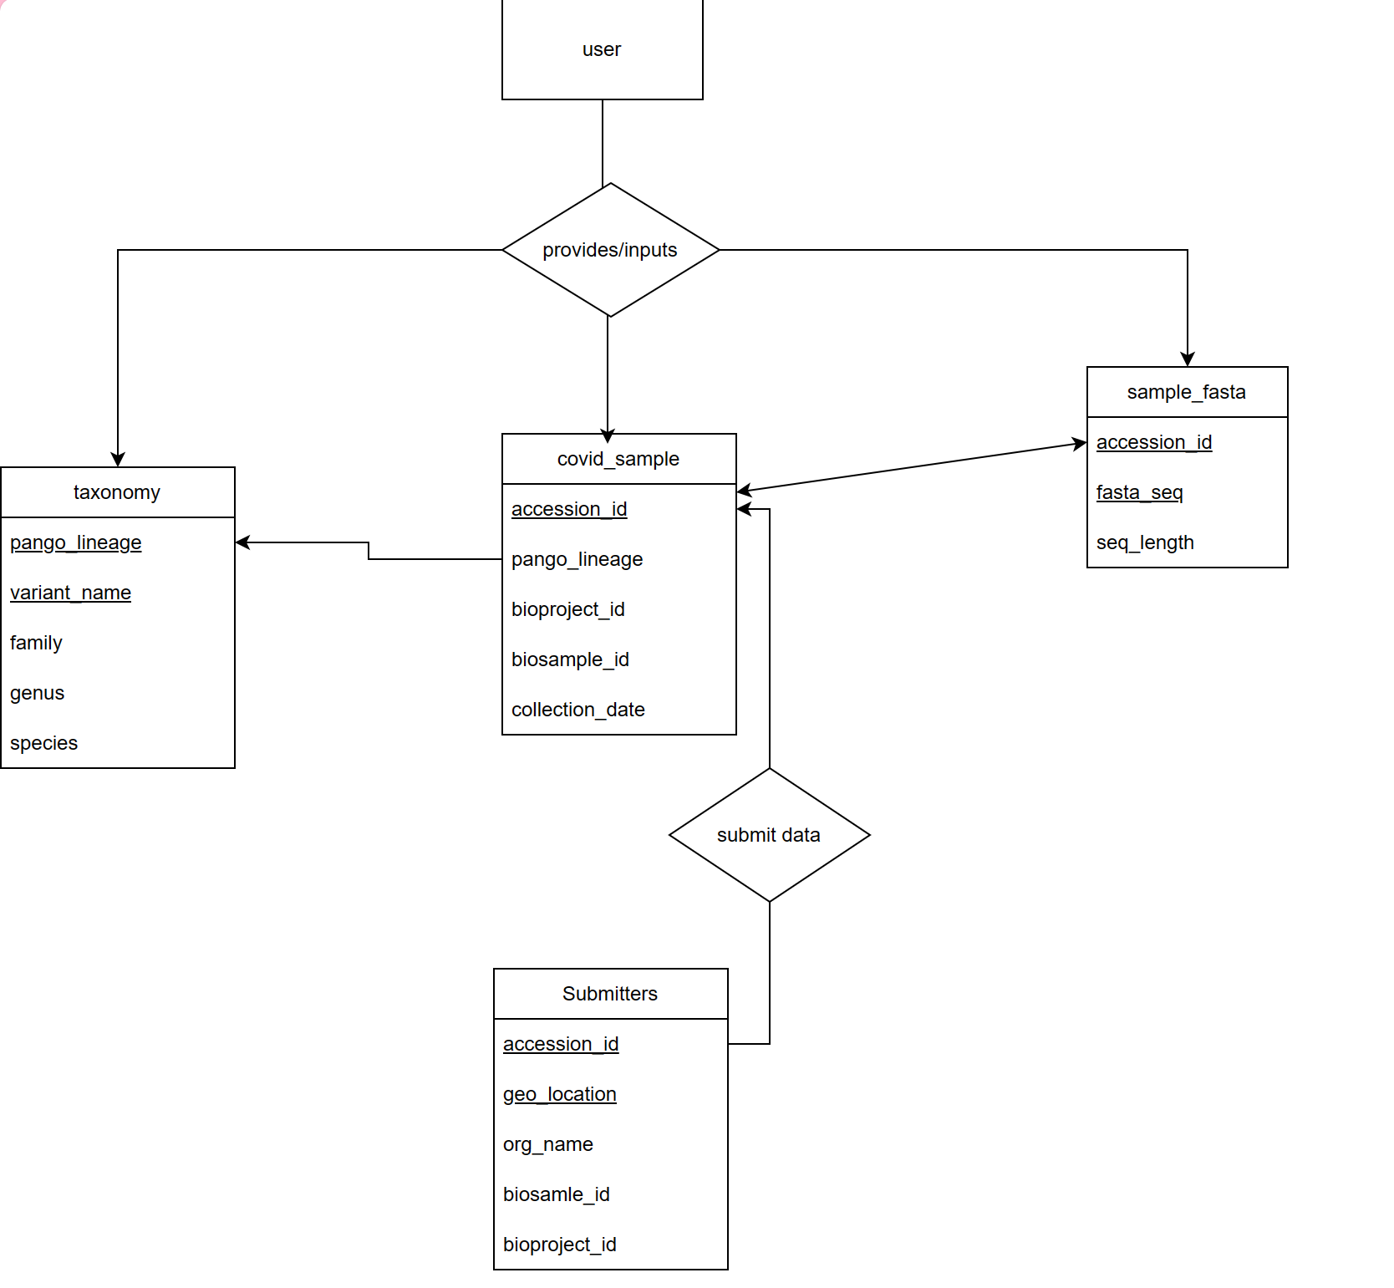
Implementation
This database was implemented on the odin server UNO offers
MySql, PHP and HTML were used as the primary languages
I chose to create a relational database
SQL dumps were utilized to get the data into tables, and PHP was used to connect the MySQL database with the front-end

Slide 6
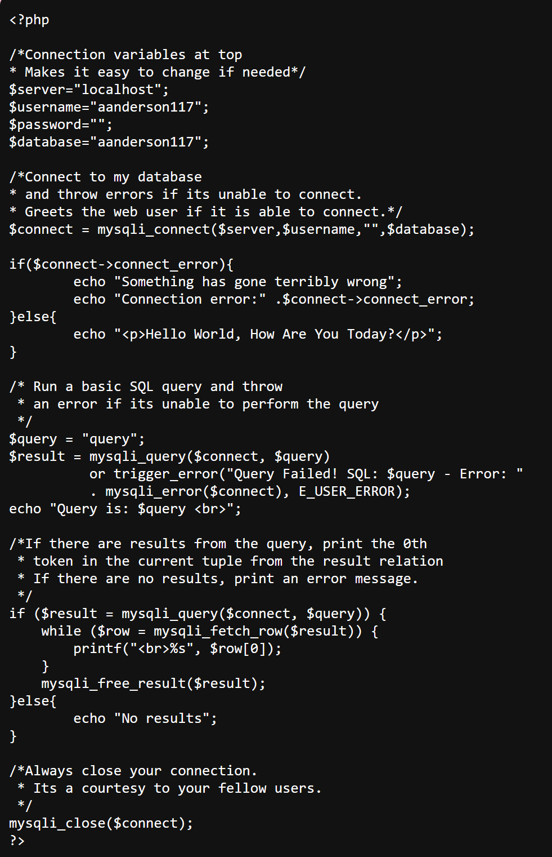
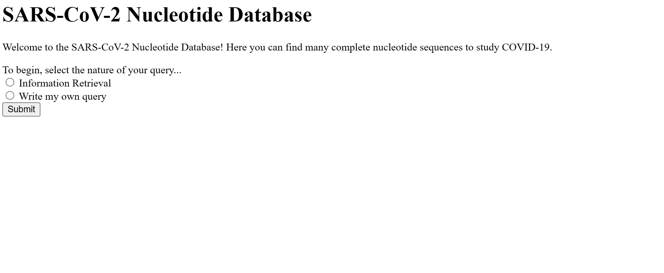
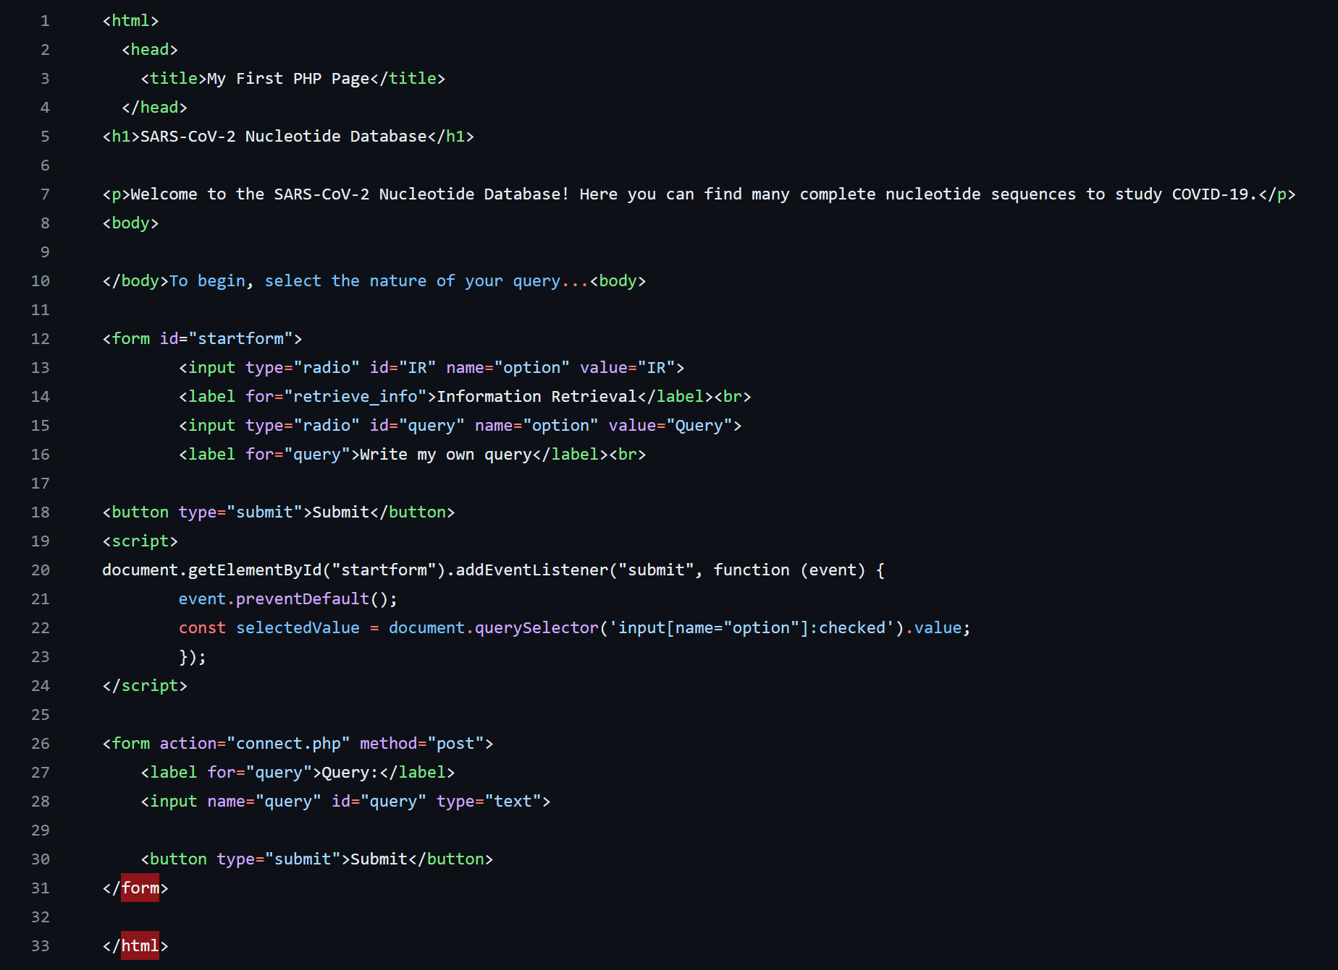
Demonstration

Slide 7

Challenges
SQL Dump issues
Modifying tutorial script to possible MySQL/odin updates
Connecting SQL to PHP/HTML is kind of hard
Conceptually difficult for me
Event-driven website programming
Time Management!!!

Slide 8
Conclusions
My SARS-CoV-2 Nucleotide Database has the potential to be a resource for those studying COVID-19 on a genomic level
It meets the requirements for being a relational database (entities, attributes, relationships)
Future directions: Protein sequences, ability to submit a sequence and be returned a match (BLAST-style)

Slide 9
Thank You!

